Slide 1
Cognitive tasks & Questionnaires
Summer School UNSW 2020: Research Lab 3
Jennifer Sloane
Tehilla Mechera-Ostrovsky

Slide 2

Goals
Have a solid understanding of each cognitive tasks used in our experiment
Cognitive Reflection Test
Flanker Task
Random Dot Motion Paradigm
Have a solid understanding of the surveys
Impulsivity
Self-Control
Big 5
Understand the concept of reverse coding

Slide 3
Cognitive reflection test

Slide 4
Cognitive Reflection test
What is the CRT (include one example)?
What is System 1 and System 2 processing?
What is it about the CRT questions that make them tricky?
Describe details of the experiment:
How many participants?
Who were the participants?
Were they incentivized in any way?
How long was the study?
What other questionnaires were included in the study?
What was the percentage of MIT (Massachusetts Institute of Technology) students, who had the highest CRT score? (hint: see, Table 1)

Slide 5
Cognitive Reflection test
What were the other IQ measures?
Are the IQ measures correlated? If so, how?
In the IQ section of the paper, how does the author define what the CRT measures?
What makes the CRT so attractive as an IQ test
Are there any sex differences?

Slide 6
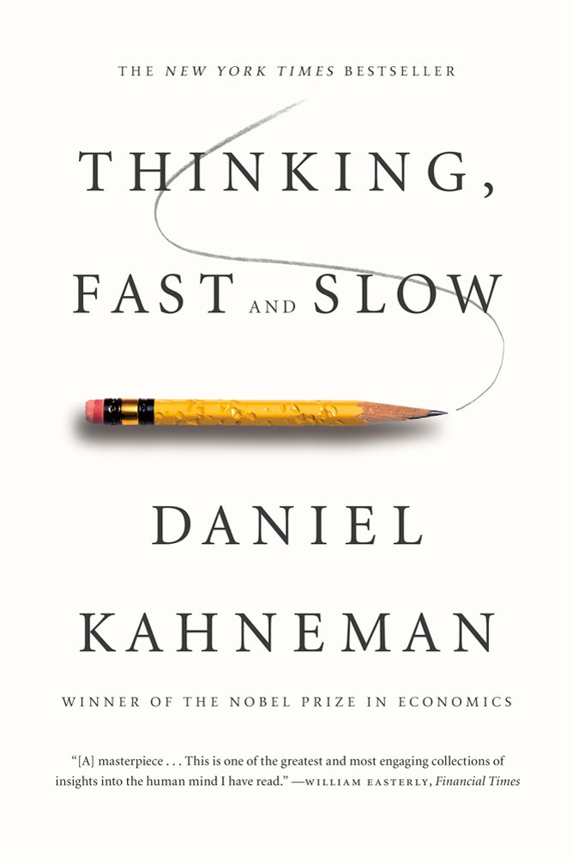
Cognitive Reflection test Discussion
Three-item psychological measure which claims to test individuals on intuitive (System 1) vs. analytic (System 2) cognitive processing
A bat and a ball cost $1.10 in total. The bat costs $1.00 more than the ball. How much does the ball cost? _____ cents
(2) If it takes 5 machines 5 minutes to make 5 widgets, how long would it take 100 machines to make 100 widgets? _____ minutes
(3) In a lake, there is a patch of lily pads. Every day, the patch doubles in size. If it takes 48 days for the patch to cover the entire lake, how long would it take for the patch to cover half of the lake? _____ days
5 cents (not 10)
5 minutes (not 100)
47 days (not 24)
(Frederick, 2005)

Slide 7
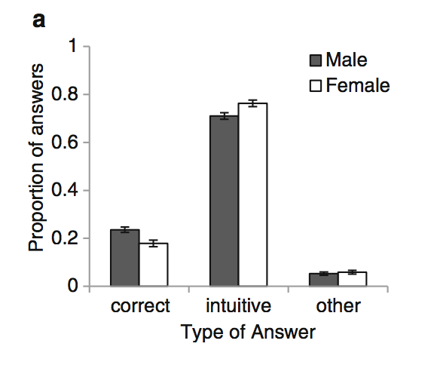
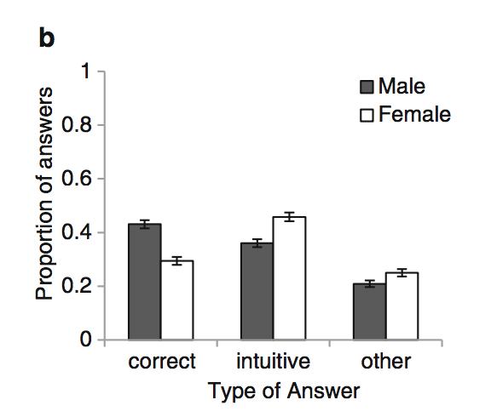
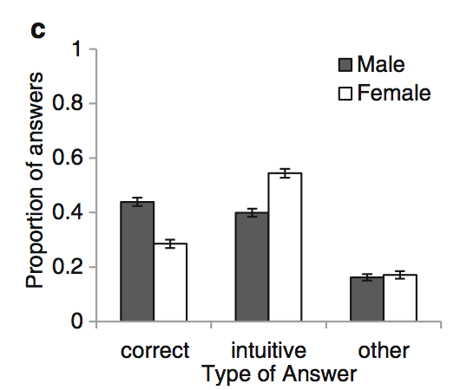

Cognitive Reflection test Discussion
Three-item psychological measure which claims to test individuals on intuitive (System 1) vs. analytic (System 2) cognitive processing
(Campitelli,& Gerrans, 2014)

Slide 8
Cognitive Reflection test Discussion
Three-item psychological measure which claims to test individuals on intuitive (System 1) vs. analytic (System 2) cognitive processing
.44 correlation between CRT performance and SAT scores (Frederick, 2005)
.40 correlation between CRT and cognitive ability (WASI Comp + WM)
Very popular because the questions lead the decision-maker to an incorrect, yet intuitive response that must be inhibited in order to arrive at the correct response
Guess how many times Frederick (2005) has been cited?
Google scholar: Cognitive reflection and decision-making… 4453!!!
Notes:
WASI – some intelligence scale

Slide 9
Flanker task

Slide 10
Flanker task
Atmaca, Sebanz, Knoblich (2011)
What is “social facilitation”?
Are people faster/slower and more/less accurate when they see someone else performing the same action?
What about if someone else is performing the opposite action?
What is “task co-representation” and “shared task representation”?
What is S-R?
What is SNARC?
What is a neutral trial on the flanker task?

Slide 11
Flanker task
Atmaca, Sebanz, Knoblich (2011)
Order from fastest RT to slowest (prediction): Neutral, compatible, incompatible, identical
What is an individual condition vs. joint condition?
What did the authors predict?
Briefly describe Experiment 1. (what was manipulated, what were the conditions)
How many participants?
What did the stimulus look like?
What were targets?
What were response keys?
There are several results listed, pick one and explain what they found

Slide 12
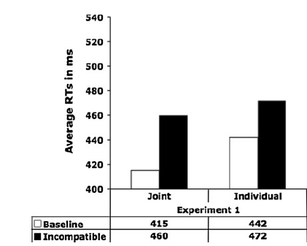
Flanker task Discussion
Incompatible trials, on average, took longer
There appears to be a larger difference in RTs between baseline and incompatible in the joint condition
Faster RTs for baseline in the joint condition compared to the individual condition

Slide 13
Flanker task Discussion
Stroop Task:
Say the color of the word out loud as quickly as possible

Slide 14
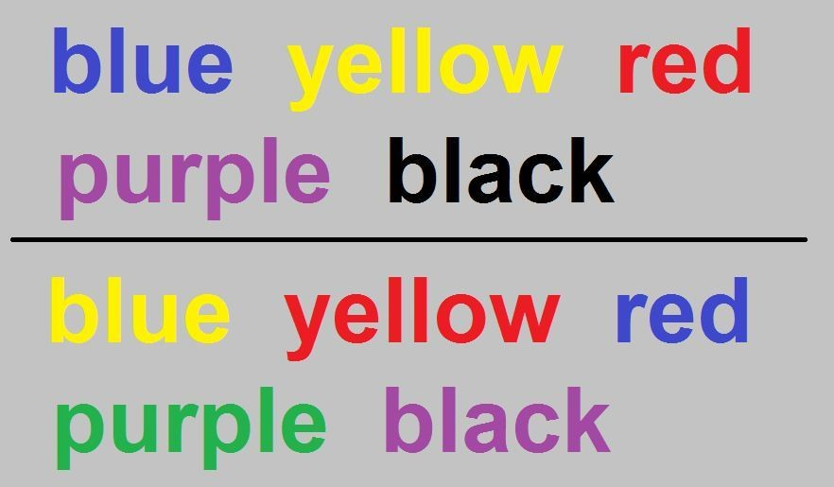

Slide 16
Flanker task Discussion
How are the Stroop and Flanker Tasks similar?

Slide 17
Random dot motion paradigm

Slide 18
Random dot motion paradigm
Mulder et al. (2013)
What is the RDM task?
Describe 2 ways you could make the RDM more challenging?
What is the speed-accuracy tradeoff (you can google it)?
What is RTP?
Explain the difference between RDM and RTP?
What did participants have to do in this study?
Who were the participants?

Slide 19
Random dot motion paradigm
Mulder et al. (2013)
What manipulation was used to make the RTP more challenging?
In the RTP task, what happened if the participant responded too slowly?
To understand the results, look at Figure 3. As best as you can, explain what you see.
Are you surprised by these findings? Why or why not

Slide 20
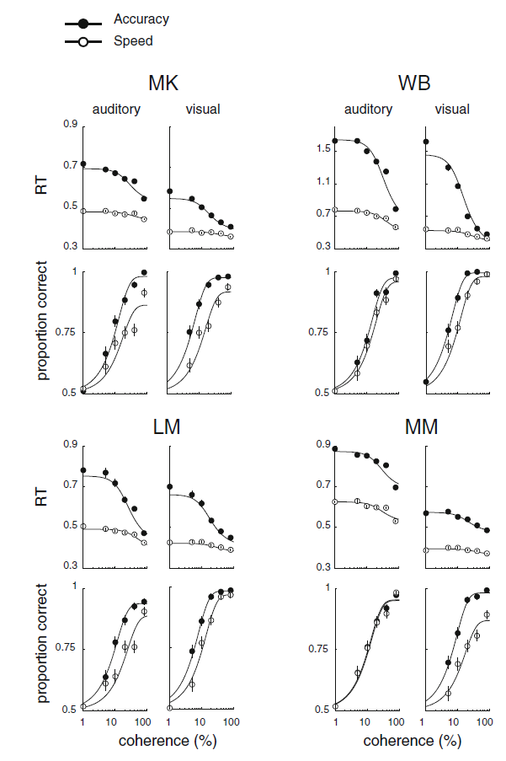
Random dot motion paradigm Discussion
MK, WB, LM, MM – the 4 authors/4 participants
What are advantages/disadvantages to having hundreds of participants vs. 4?
With the accuracy manipulation: participants respond slower, but are more accurate
With the the speed manipulation: participants respond faster, but are less accurate
The pattern of data looks similar for auditory and visual

Slide 21
Questionnaires

Slide 22
Questionnaires
Barratt impulsiveness scale (bis) – 30 items
*I plan tasks carefully
I do things without thinking
*I make-up my mind quickly
*I plan trips well ahead of time
Self Control Scale – 13 items
I am good at resisting temptation
*I have a hard time breaking bad habits
I refuse things that are bad for me
*I have trouble concentrating
Big 5 (short) – 15 items
Worries a lot (N)
*Is reserved (E)
Has an active imagination (O)
Has a forgiving nature (A)
Scale: Rare/Never, Occasionally, Often, Almost Always/Always
Scale:
1: Not at all, 2, 3, 4, 5: Very Much
Scale: Disagree strongly, Disagree a little, Neither, Agree a little, Agree strongly

